Slide 1

Robotics
Coding
Circuit Design
Games and Apps Development
Physiotherapy Bot with Dialog Flow
Machine Learning with Dialogue Flow
…Nurturing STEM Skills for the future
www.brainiacs.com.ng
Learn, Play, Innovate

Slide 2

Wow Factor
www.brainiacs.com.ng
Learn, Play, Innovate

Slide 3

Key Skills
Computational Thinking
Problem Solving
Creative Thinking
Digital Communication
www.brainiacs.com.ng
Learn, Play, Innovate

Slide 4
Learning Objectives
At the end of the lesson, learners should be able to:
I. Explain the basic concept of physiotherapy bot.
II. State the significance of physiotherapy bot in healthcare.
III. State the benefits and challenges of implementing physiotherapy bots in healthcare.
IV. Create a functional physiotherapy bot capable of performing physiotherapy related tasks
V. Integrate physiotherapy bot into social media handles.
www.brainiacs.com.ng
Learn, Play, Innovate

Slide 5
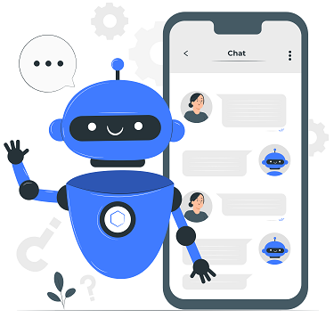
Physiotherapy Bot Concept
Physiotherapy Bots are intelligent virtual assistants designed to guide patients through personalized exercises and rehabilitation programs. These bots provide 24/7 accessibility, allowing patients to perform exercises and receive guidance remotely, reducing the need for in-person appointments.
www.brainiacs.com.ng
Learn, Play, Innovate

Slide 6

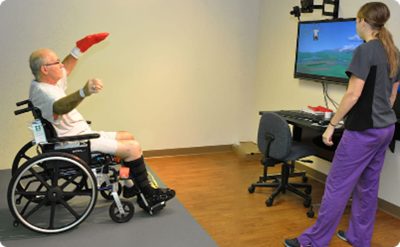
Application of Physiotherapy Bot in Healthcare
1. Physiotherapy Bots enable remote rehabilitation programs allowing patients to receive personalized care through video consultations and exercise guidance.
2. These bots help healthcare professionals monitor patients' progress, track their exercise performance, and adjust treatment plans in real-time.
www.brainiacs.com.ng
Learn, Play, Innovate

Slide 7
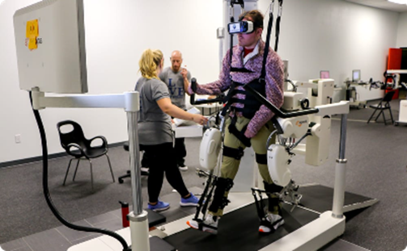
Application of Physiotherapy Bot in Healthcare (cont)
3. Physiotherapy Bots helps patients to follow prescribed exercise programs in the comfort of their own homes, improving convenience and compliance.
www.brainiacs.com.ng
Learn, Play, Innovate

Slide 8
Benefits and Challenges of Implementing Physiotherapy Bot
BENEFITS
1. It increased easy accessibility to healthcare services.
2. It is a cost-effective solution to health-related issues .
3. It improve patient engagement.
CHALLENGES
1. There is always an issue of handling sensitive patient data.
2. Current technology might limit the bot's ability to perform physical assessments, such as hands-on evaluations, which are essential in physiotherapy.
www.brainiacs.com.ng
Learn, Play, Innovate

Slide 9

Dialog Flow Integration
There are various platforms available to design physiotherapy bot. For the purpose of this lesson, we will be using the GOOGLE DIALOG FLOW
www.brainiacs.com.ng
Learn, Play, Innovate

Slide 10
Dialog Flow Integration(cont)
GOOGLE DIALOG FLOW: Dialog flow is a natural language understanding platform, used to design chatbot interface for mobile apps, web applications, mobile devices and interactive voice response systems.
Integrating dialogue flow capabilities ensures that Physiotherapy Bots can understand and respond to patients' natural language inputs, making the interaction more intuitive.
www.brainiacs.com.ng
Learn, Play, Innovate

Slide 11
Designing a Conversational Flow for Physiotherapy
While designing a physiotherapy bot we followed steps:
Step1: Sign into google dialogue flow with you google account.
Step2: Create your Agent
Step3: List your ntent
Step4: Train your Agent
Step5: Test and Deploy using web demo and various social media handles
www.brainiacs.com.ng
Learn, Play, Innovate

Slide 12

Designing a Physiotherapy Bot
Visit https://dialogflow.cloud.google.com/#/login using a web browser
Ensure to sign in with your Gmail address
(1) Click “sign in” to register with your Gmail.
www.brainiacs.com.ng
Learn, Play, Innovate

Slide 13
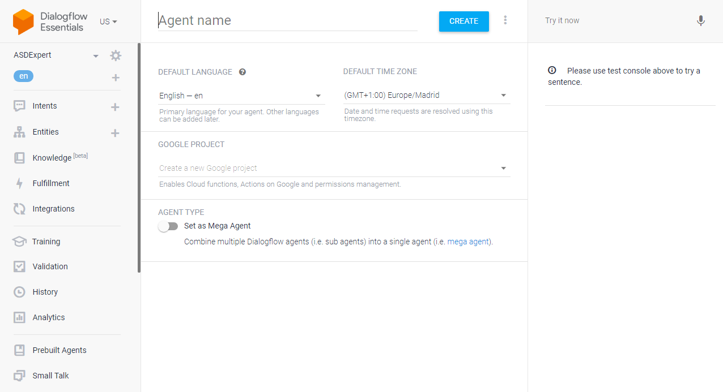
Designing a Physiotherapy Bot (cont)
Test Section
Menu
Working Area
www.brainiacs.com.ng
Learn, Play, Innovate

Slide 14
Designing a Physiotherapy Bot (cont)
(2) Enter Agent name and click create
www.brainiacs.com.ng
Learn, Play, Innovate

Slide 15
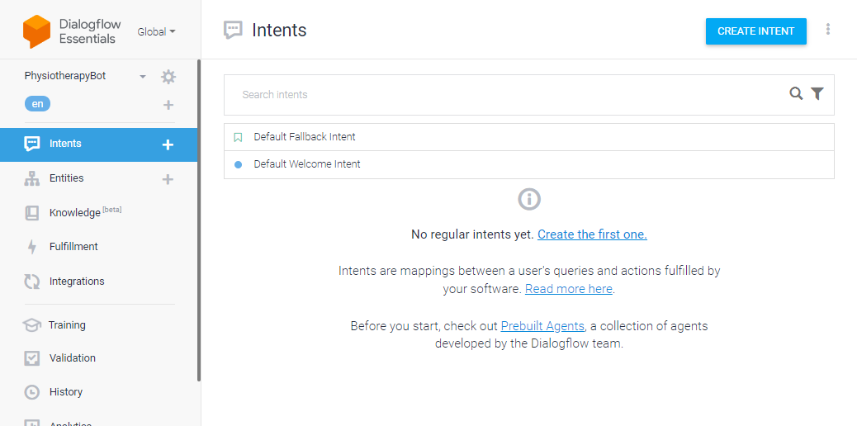
Designing a Physiotherapy Bot (cont)
(3) Click on “create intent”
www.brainiacs.com.ng
Learn, Play, Innovate

Slide 16
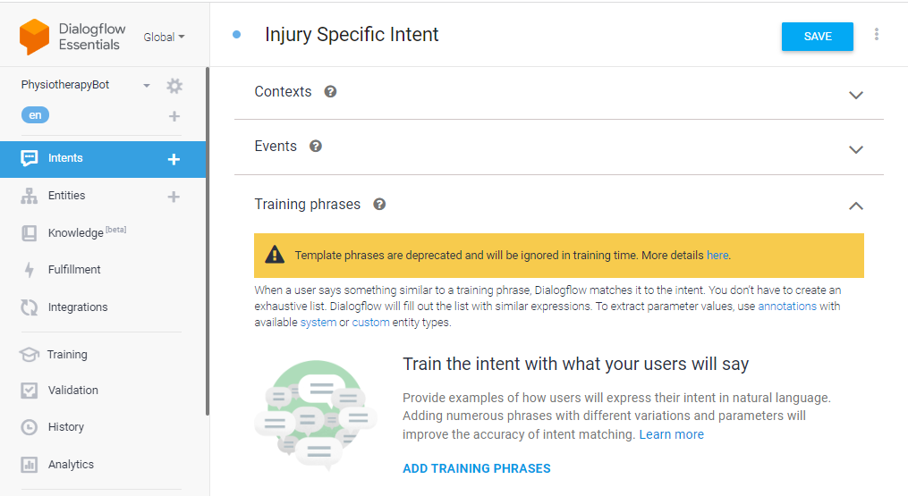
Designing a Physiotherapy Bot (cont)
(4) Name and save your intent
(3) Scroll down to training phrase. Click Add training phrase and add possible questions
www.brainiacs.com.ng
Learn, Play, Innovate

Slide 17
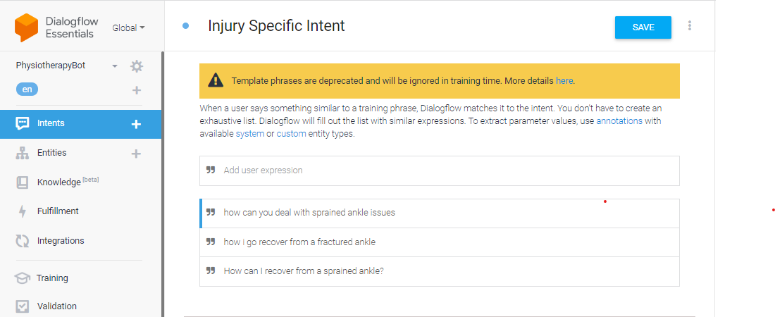
CoviBot(cont)
Designing a Physiotherapy Bot(cont)
(5) Add Possible questions. These are some questions people may likely ask your Physiotherapy Bot
(6) Click here to save
www.brainiacs.com.ng
Learn, Play, Innovate

Slide 18
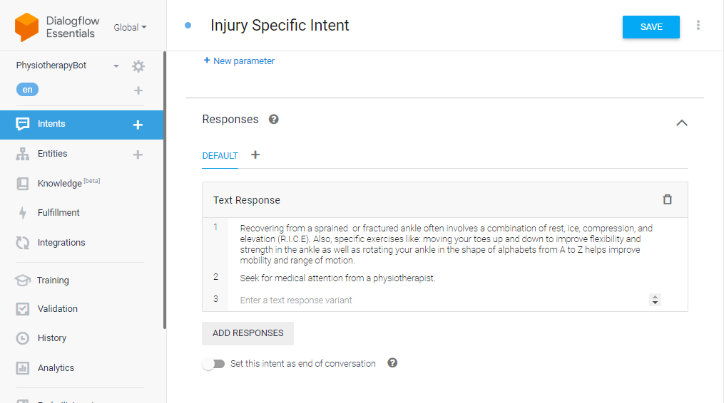
CoviBot(cont)
Designing a Physiotherapy Bot (cont)
(8) Click on save
(7) Scroll down to find Responses drop down icon. Click on it and insert Reponses
www.brainiacs.com.ng
Learn, Play, Innovate

Slide 19
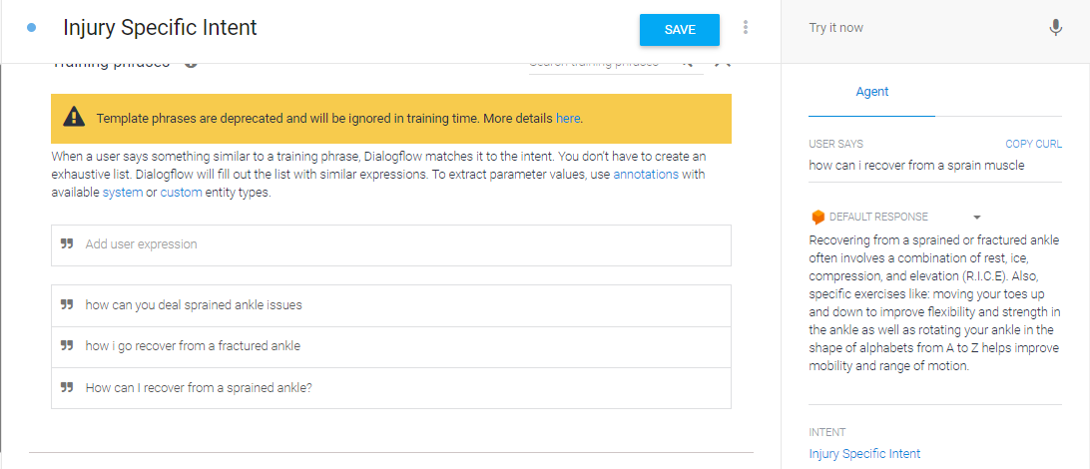
CoviBot(cont)
Designing a Physiotherapy Bot
(cont)
(9) Type possible question or say something to your agent and see if it responds appropriately
www.brainiacs.com.ng
Learn, Play, Innovate

Slide 20
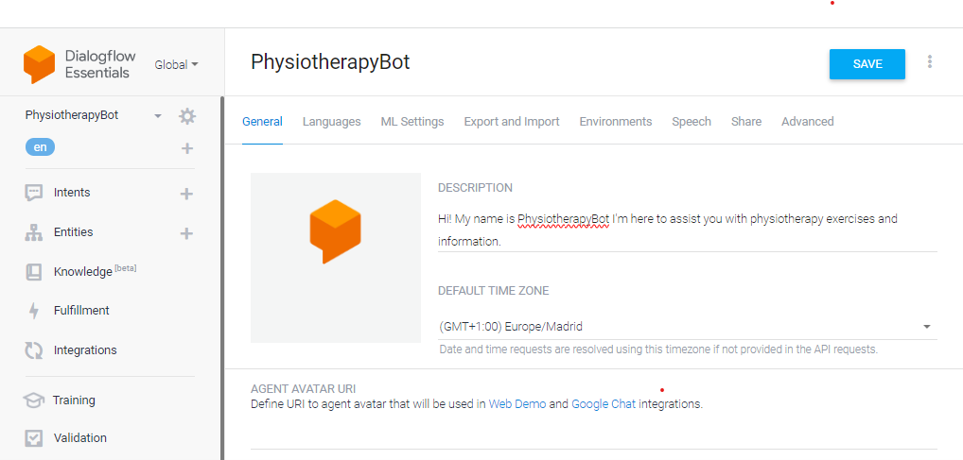
CoviBot(cont)
Designing a Physiotherapy Bot (cont)
(12) Click on Save
(10) Click on this icon
(11) Give your agent a description
www.brainiacs.com.ng
Learn, Play, Innovate

Slide 21
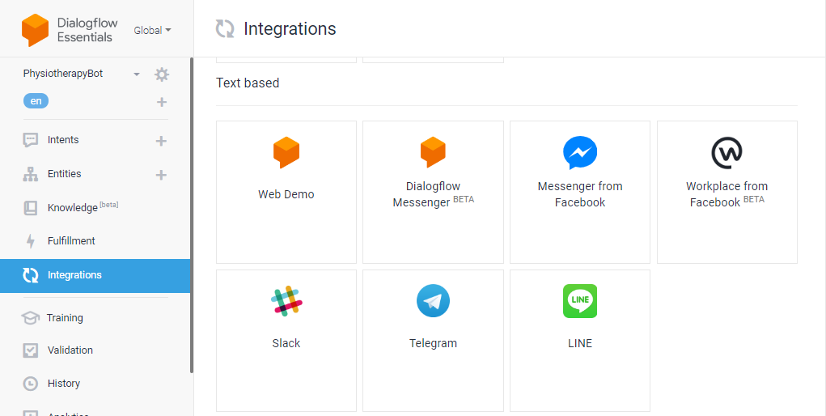
CoviBot(cont)
Designing a Physiotherapy Bot (cont)
(14) Click on web demo to test your bot on the web
(13) Click on integration
www.brainiacs.com.ng
Learn, Play, Innovate

Slide 22
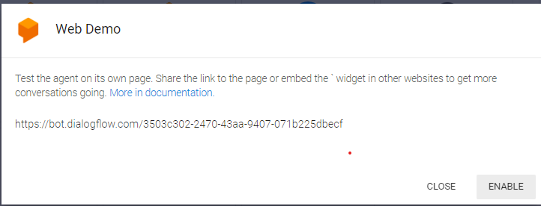
CoviBot(cont)
Designing a Physiotherapy Bot (cont)
(15) Click on Enable
www.brainiacs.com.ng
Learn, Play, Innovate

Slide 23
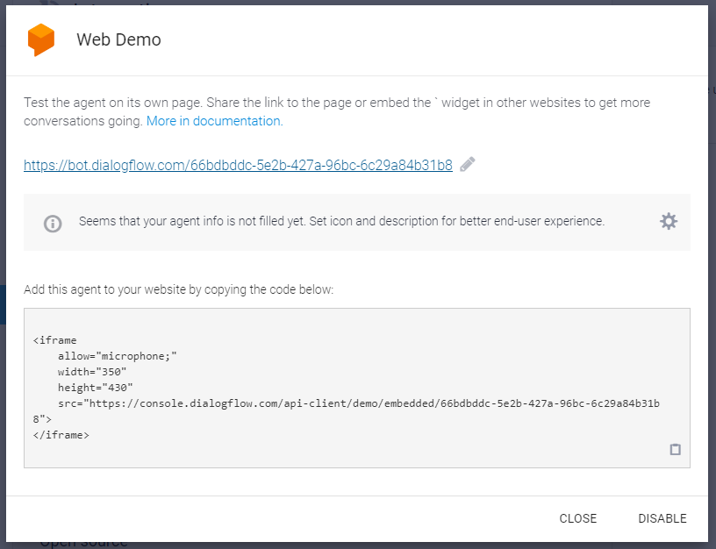
CoviBot(cont)
Designing a Physiotherapy Bot (cont)
(16) Click on the link to view your bot on the web
www.brainiacs.com.ng
Learn, Play, Innovate

Slide 24
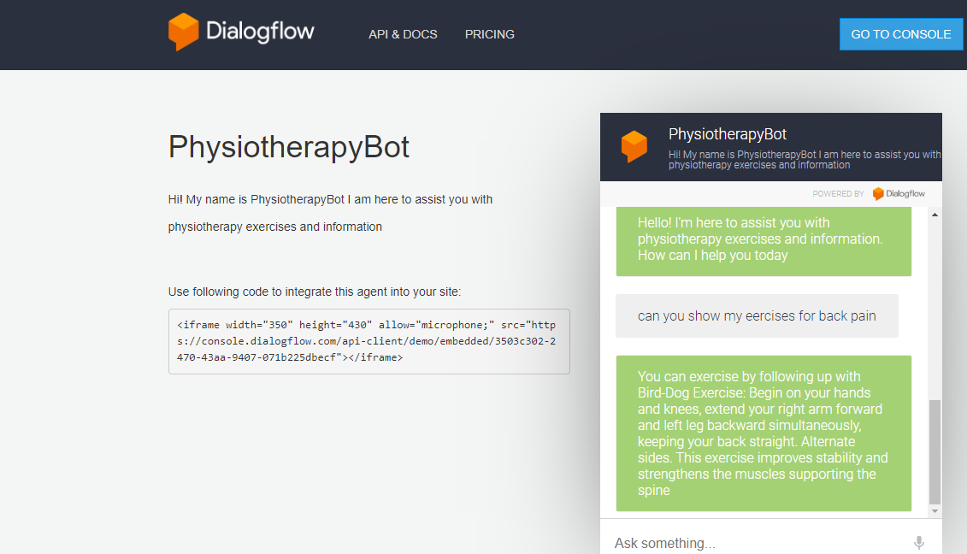
CoviBot(cont)
Testing the Physiotherapy Bot (cont)
Put the Physiotherapy Bot to the test by asking it possible physiotherapy question
You can also test it by asking it a question you haven't trained it to answer and see the response
www.brainiacs.com.ng
Learn, Play, Innovate

Slide 25
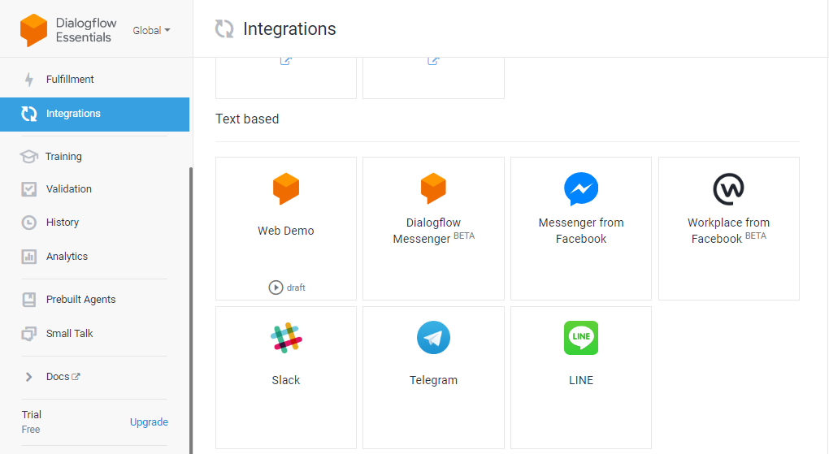
CoviBot(cont)
Physiotherapy Bot Integration (cont)
Click on any of this social media platform to integrate your PhysiotherapyBot into the various handles
www.brainiacs.com.ng
Learn, Play, Innovate

Slide 26
Lesson Outcomes
Learners are able to:
Explain the concept of Physiotherapy Bot.
State two applications of Physiotherapy Bot in Healthcare.
State three benefits and challenges of implementing Physiotherapy Bot.
Design PhysiotherapyBot using Google Dialog Flow.
www.brainiacs.com.ng
Learn, Play, Innovate
Notes:
A Quick recap of the day’s lesson

Slide 27

Well-done!
www.brainiacs.com.ng
Learn, Play, Innovate

Slide 28
Contact Us
Phone No: +234 909 109 5057
Email: brainiacsng@gmail.com
info@brainiacs.com.ng
Website: www.brainiacs.com.ng
Google+: brainiacsng
Twitter: Brainiacs_Ng
Facebook: Brainiacs Nigeria
Youtube Channel: Brainiacs_Ng
www.brainiacs.com.ng
Learn, Play, Innovate

